Slide 1


HOUSE Liaisons: Addressing College Student Homelessness
Ashley Lewis | Assistant Director of Policy Research| February 21, 2025

Slide 2
Homeless Youth Statistics
In 2019, 4.2 million youth and young adults experienced homelessness over last year according to Chapin Hall at the University of Chicago
2021 HOPE Center #Real College Survey
  Fielded at 530 colleges and universities
  Over 550,000 students responded
    43% of respondents at 4-year institutions experienced housing insecurity
    14% self-identified as experiencing homelessness
  The HOPE Center fielded a new survey between January 2023 and July 2024.
    Only preliminary results available
      Survey completed in 16 states at 91 schools
      48% students experienced housing insecurity
      14% experienced homelessness

Slide 3
Illinois General Assembly Passes P.A. 102-0083
In Summer 2021, Illinois General Assembly passed Higher Education Housing and Opportunities Act
This law required all institutions of higher education (including public, private, 2- and 4-year schools) to designate a HOUSE Liaison by August 2022
Law requires institutions that provide housing to:
  Grant priority housing during academic breaks to students experiencing homelessness and waiving the fees.
  Allow part-time students who are experiencing homelessness access to on-campus housing.
  Provide information on availability of on-campus housing to students experiencing homelessness.
  Provide information about the institution’s services and assistance in financial aid and admissions packets and the institution’s website.

Slide 4
Definition of Homeless Student
  An individual enrolled in an institution who lacks or is at imminent risk of lacking a fixed, regular, and adequate nighttime residence or whose parent or legal guardian is unable or unwilling to provide shelter and care and includes a homeless individual as defined under the federal McKinney-Vento Homeless Assistance Act. For the purposes of this definition, the term "fixed, regular, and adequate nighttime residence" does not include residence in an institution of higher education's on-campus housing.

Slide 5

HOUSE Liaison Student-Related Duties Under P.A. 102-0083
Understanding financial aid eligibility laws, including those under the Higher Education Act of 1965, and assisting homeless youth or students in care in applying for federal and state financial aid.
Identifying services and resources for homeless students/youth in care and acting as an intermediary between the student and other institutional departments, such as financial aid and housing.
Connecting homeless students/youth in care to local continuum of care program.

Slide 6
HOUSE Liaison Administrative-Related Duties under P.A. 102-0083
Tracking graduation and retention rates of homeless students and youth in care at the institution.
Annually reporting to IBHE on the number of homeless students and youth in care at the institution and any services such students received.
Publishing information about services and resource on the institution’s website.
Developing a plan to provide access to housing during academic breaks.
Training institution employees on how to identify homeless students.

Slide 7
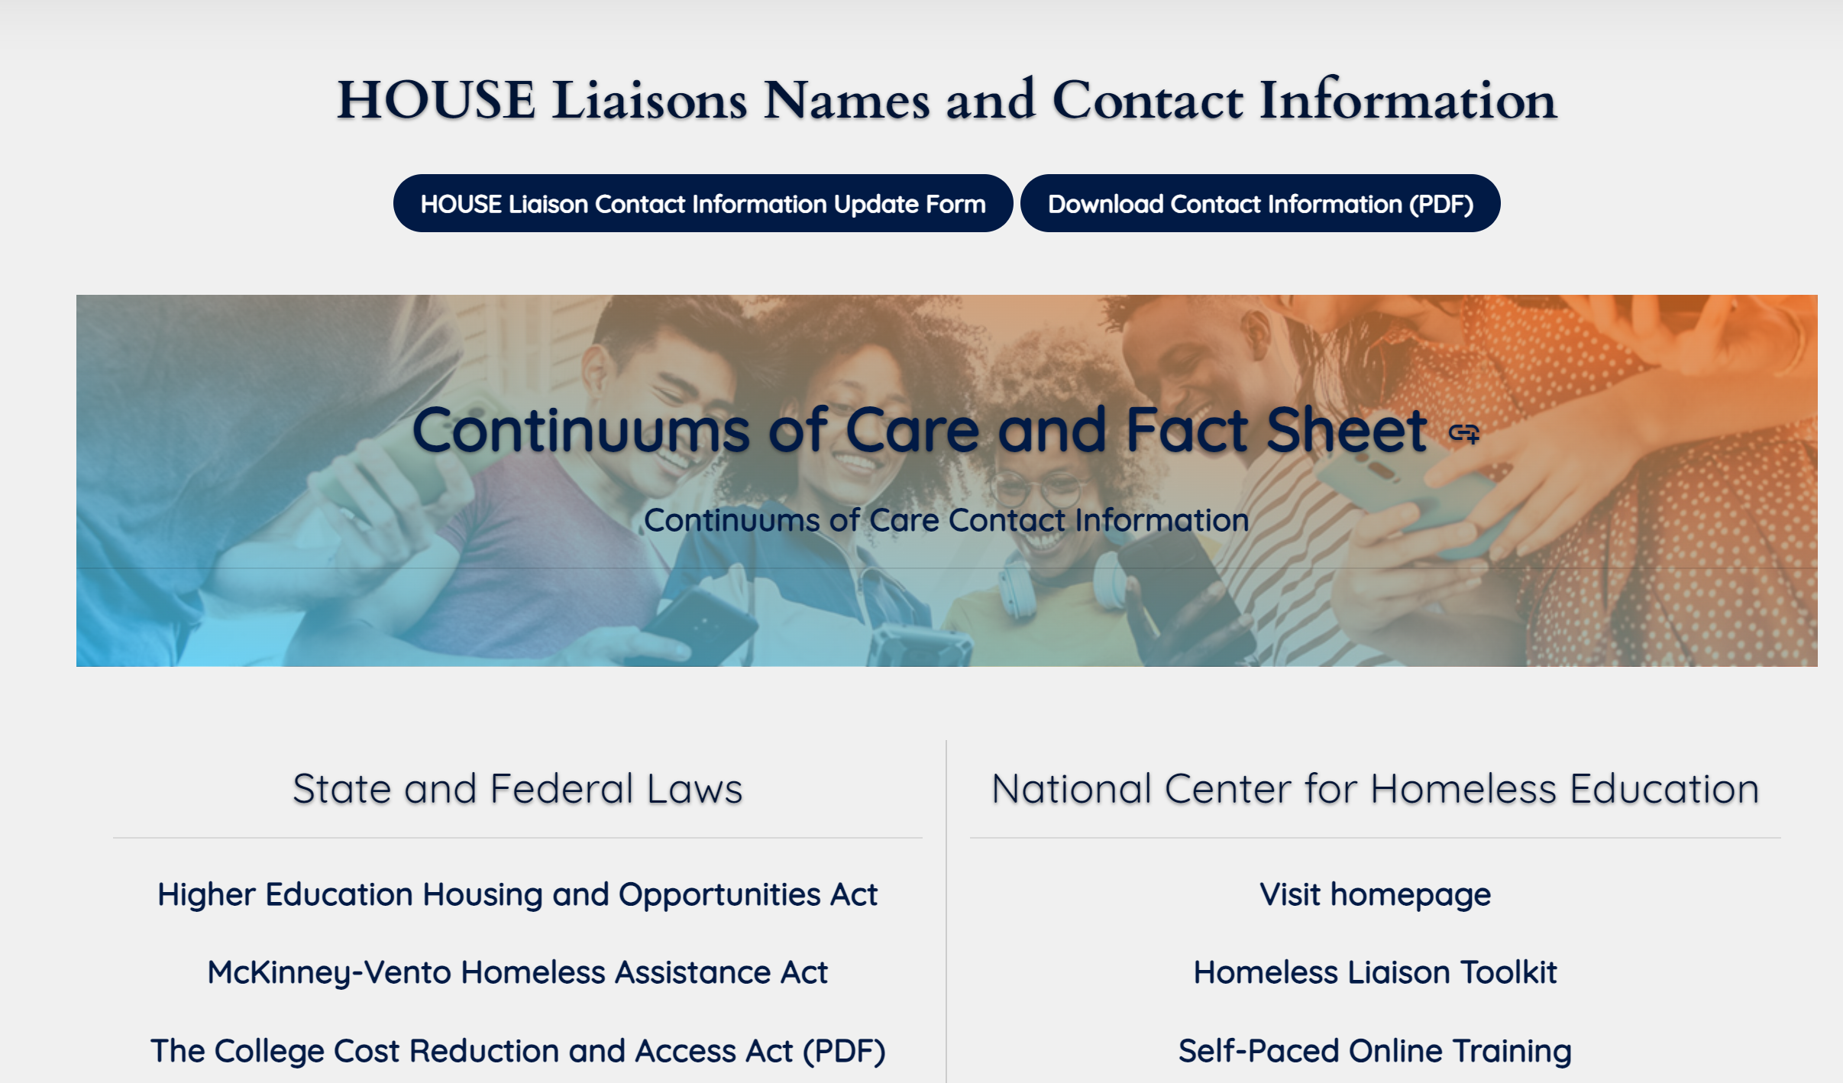
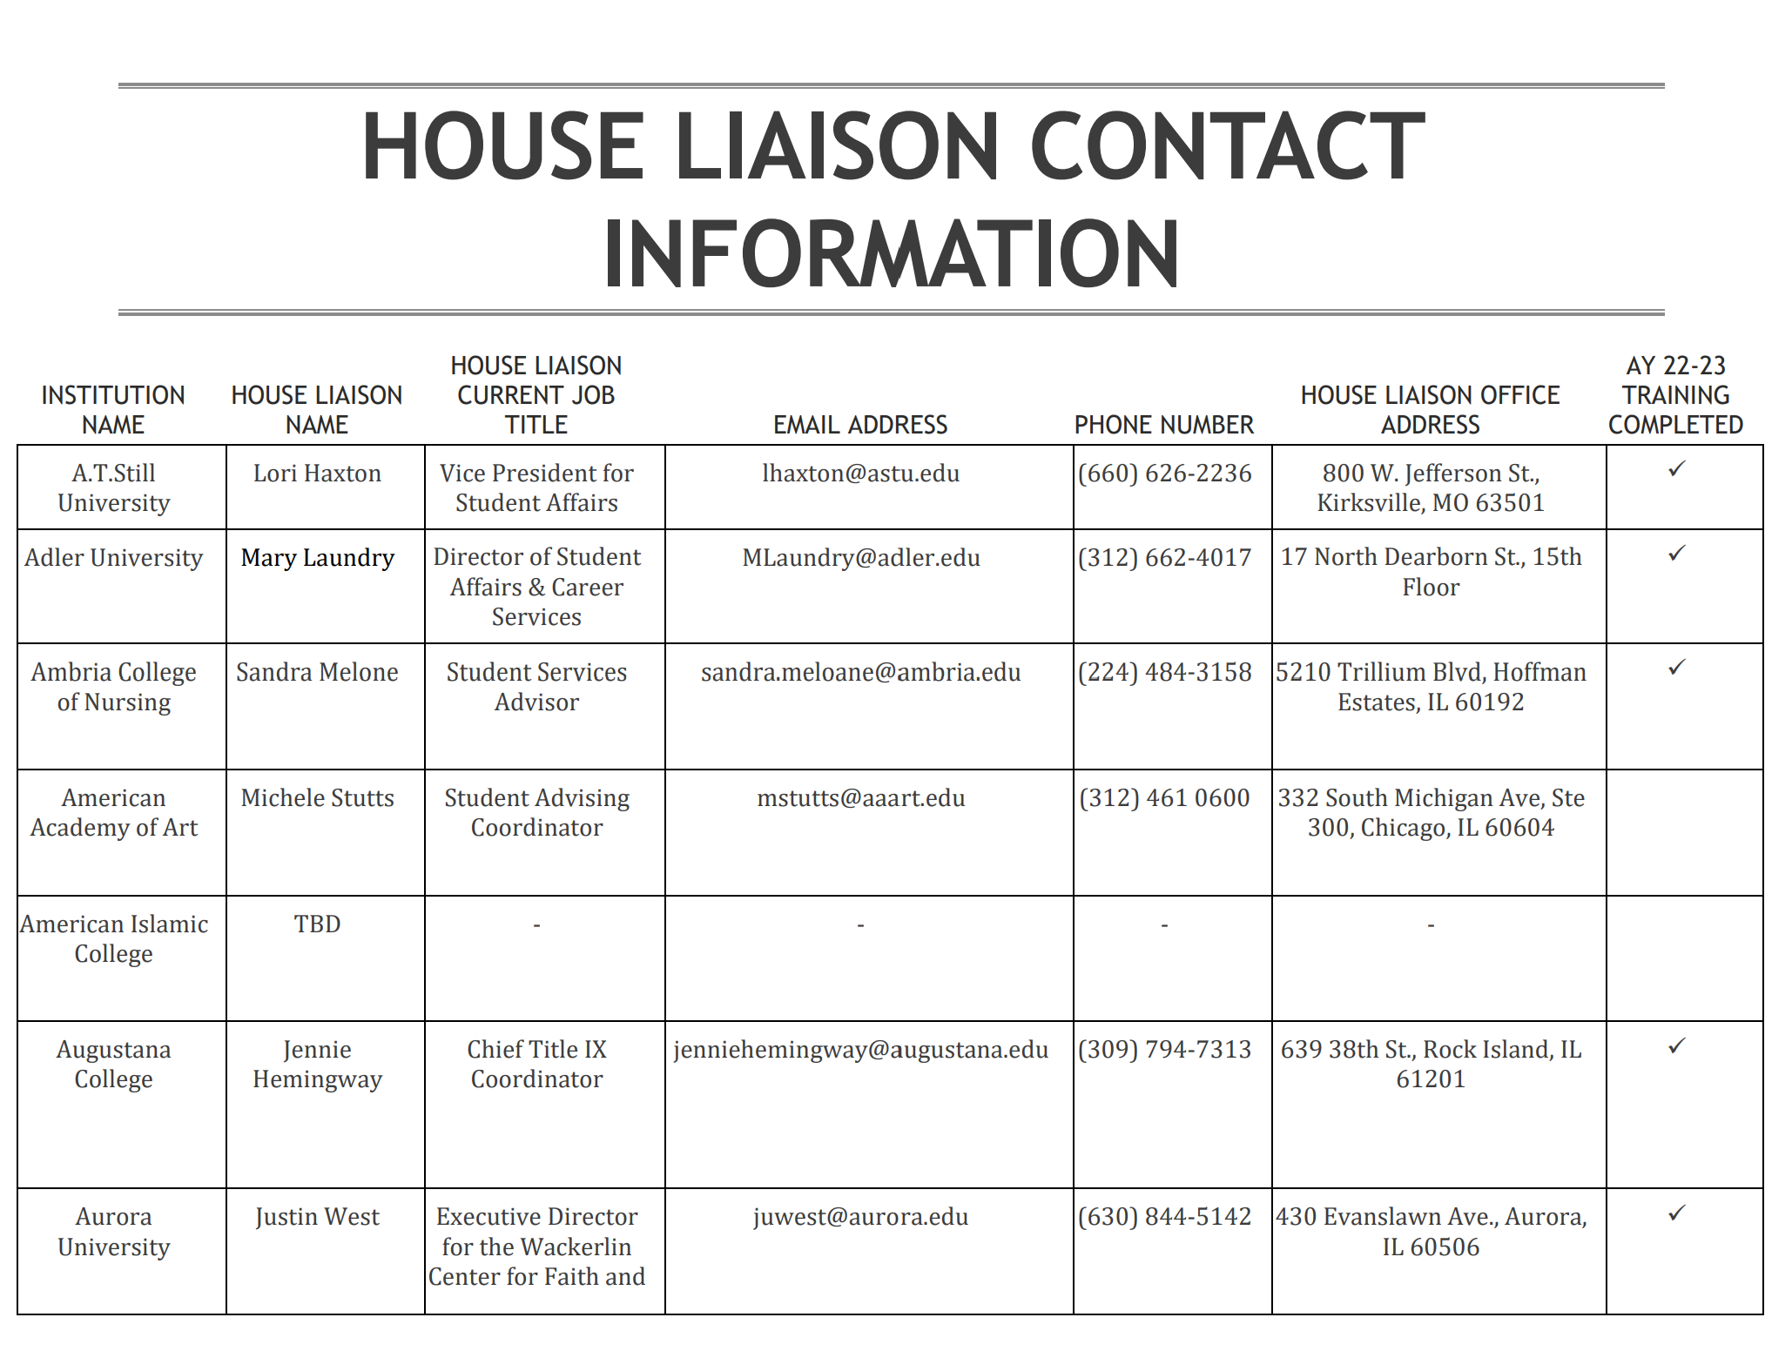
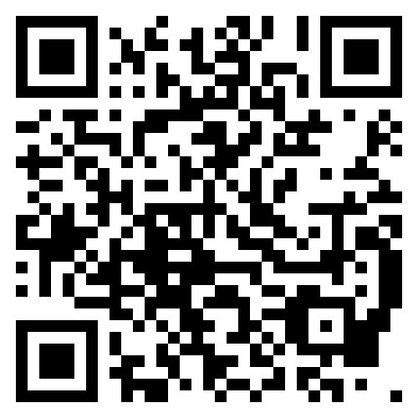
IBHE HOUSE Liaison Website
Website: IBHE HOUSE Liaisons

Slide 8
HOUSE Liaison First Data Collection General Information
HOUSE Liaisons required to report annually to IBHE or ICCB under Higher Education Housing and Opportunities Act (110 ILCS 131/10)
Second data collection took place in Fall 2024, but is still being analyzed.
FY 2023 HOUSE Liaison Reporting Form fielded from September 29, 2023 to October 30, 2023 for universities
Form asked questions about HOUSE Liaison, HOUSE Liaisons statutory duties, and services HOUSE Liaison provided during August 2022 through June 2023
90 institutions (out of 133) completed in the required timeframe
443 homeless students reported at 35 institutions; 273 youth in care reported at 22 institutions
All other institutions reported 0 homeless and/or youth in care

Slide 9
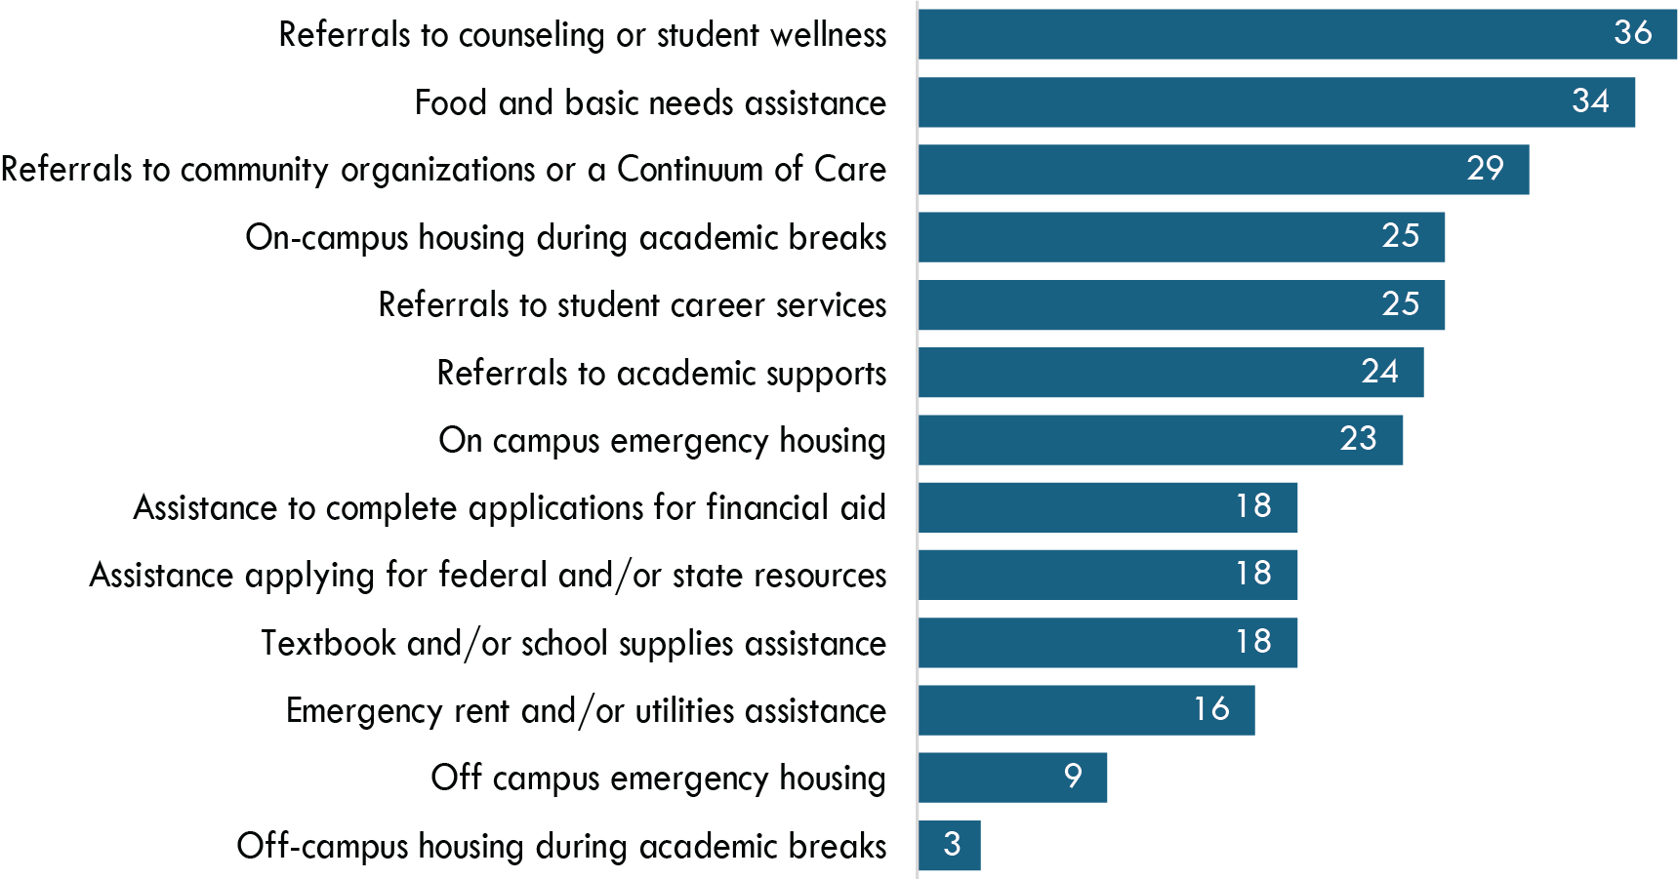
Number of Institutions Reporting Offering Selected Student Support Services, FY 2023

Slide 10
Total Number of Students Served and Costs of Services, FY 2023
Service | Total Number of Institutions Reporting to Offer the Service | Total Number of Students Utilizing Service | Total Number of Institutions Reporting Cost | Total Cost to Offer the Service at All Institutions Reported Offering
Referrals to counseling or student wellness | 36 | 1,345 | N/A | N/A
Food and basic needs assistance | 34 | 2,101 | 18 | $193,836
Referrals to community organizations or a Continuum of Care | 29 | 603 | N/A | N/A
On-campus housing during academic breaks | 25 | 141 | 19 | $121,290
Referrals to student career services | 25 | 497 | N/A | N/A
Referrals to academic supports | 24 | 164 | N/A | N/A
On campus emergency housing | 23 | 131 | 18 | $309,083
Assistance to complete applications for financial aid | 18 | 164 | N/A | N/A
Assistance applying for federal and/or state resources | 18 | 211 | N/A | N/A
Textbook and/or school supplies assistance | 18 | 198 | 16 | $72,170
Emergency rent and/or utilities assistance | 16 | 464 | 15 | $354,074
Off campus emergency housing | 9 | 29 | 7 | $23,308
Off-campus housing during academic breaks | * | * | * | *

Slide 11
End Student Housing Insecurity (ESHI) Grants - FYs 2023 & 2024
In FY 2023, 11 recipients awarded grants of $50,000 each for January to June 2023
FY 2024, ESHI grants awards increased to up to $200,000 to 10 institutions for November to June grant period.
Common uses of funding:
  Emergency funding for student housing
  Other emergency funding for food, transportation, or medical expenses
  Food pantry expansion into basic needs pantry
  Summer Bridge Programs for students at risk of homelessness
  Vocational preparation program
  Childcare assistance vouchers
  Creation of long-term housing space for a college’s students at a community-based organization

Slide 12
End Student Housing Insecurity (ESHI) Grants - FY 2025
In FY 2025, $2 million was again awarded to IBHE for ESHI Grants.
11 ESHI Grants of up to $200,000 were awarded
FY 2025, ESHI Grant’s put increased focus on McKinney-Vento and foster youth
  Population that is already known to be homeless or experiencing housing insecurity
  Facilitation on easy transition form high school to college
  Institutions are allowed to pay room and board fees for this population only
  Other common uses of funding for this population include:
    Bedding and dorm room supplies
    Basic Needs Supplies
    Summer Immersion Programs

Slide 13
Other Initiatives Relating to Basic Needs
Benefits Navigators
  Required at all public colleges and universities by P.A. 102-1045 (passed in 2022)
  Assists students in determining eligibility in benefits programs, coordinate culturally-specific resources for non-English speakers, and attend Communities of Practice meetings hosted by IBHE and/or ICCB (Communities of Practice: Benefits Navigator IBHE)
Veterans Coordinators
  Required at all public colleges and universities with over 1,000 students by 110 ILCS 49/15
  Serves specific needs of military members and their families and serve as centralized source to help such students receive all benefits and resources
Undocumented Student Liaison
  Required at all public colleges and universities by P.A. 102-475
  Aids undocumented and mixed status students regarding financial aid and academic support

Slide 14


